Slide 1
Open Source Platform and Network Administration
Lesson 14

Slide 3
Learning Objective
Assess how firewall, Transmission Control Protocol (TCP) Wrappers, and Security Enhanced Linux (SELinux) complement one another to secure network applications.

Slide 4
Key Concepts
Basic layered security concepts of a Linux infrastructure
Firewall with iptables
Application layer security with TCP Wrappers
Benefits of mandatory access control (MAC) with SELinux

Slide 5
Obscurity and the Open Port Problem
Obscurity promotes security
Cite nonstandard ports in configuration file
Inform users how to access obscure ports
Update firewall to accept obscure port
Configure obscure port for both TCP and UDP packets
Obscure services by login and error messages

Slide 6
TCP Wrappers
Allow or deny access to an application based on an Internet Protocol (IP) Address or hostname
Allow or deny access to an application based on time
TCP Wrappers

Slide 7
Importance of TCP Wrappers
Adds a layer of security in addition to firewalls
Can allow and restrict access to an application based on domain name and time of the day
Can spawn processes such as e-mail and logging

Slide 8
Creating TCP Wrapper Rules
The TCP Wrapper rules on the next two slides are created to allow Secure Shell (SSH) access to the fictitious site is418.com. These rules are also used to log all access with a message and date while denying access to all other users.

Slide 9
Creating TCP Wrapper Rules (Continued)
Step 1
Open the /etc/hosts.allow file using a text editor.
Type the following rule to allow and log access from the is418.com domain:
ssh:.is418.com:spawn /bin/echo `/bin/date` ssh access granted >> /var/log/sshd.log
Step 2
Step 3
Save and exit.

Slide 10
Creating TCP Wrapper Rules (Continued)
Step 4
Open the /etc/hosts.deny file using a text editor.
Step 5
Type the following rule to deny everyone else:
sshd:ALL
Step 6
Save and exit.

Slide 11
Importance of Firewalls
Can be enabled on bastion hosts in addition to existing network firewalls
Provide a layer of security at the network layer to restrict unauthorized traffic
Can protect bastion hosts from malicious local network traffic

Slide 12
Designing a Firewall
Are rules that should be cleared in place?
Turn on firewall.
Yes
Flush the current rules using the iptables –F command.
List current rules using the iptables –L command.
No
Write firewall rules for INPUT, OUPUT, and FORWARD chains.
Save the new rules using the iptables-save command.

Slide 13
Firewalls
Add, remove, and edit rules to a packet filter ruleset
List and flush the rules to a packet filter ruleset
List counters of matched packets to rules
iptables
Provides iptables packet filter in the kernel
Performs stateless and stateful packet filtering
Provides network address translation
Netfilter

Slide 14
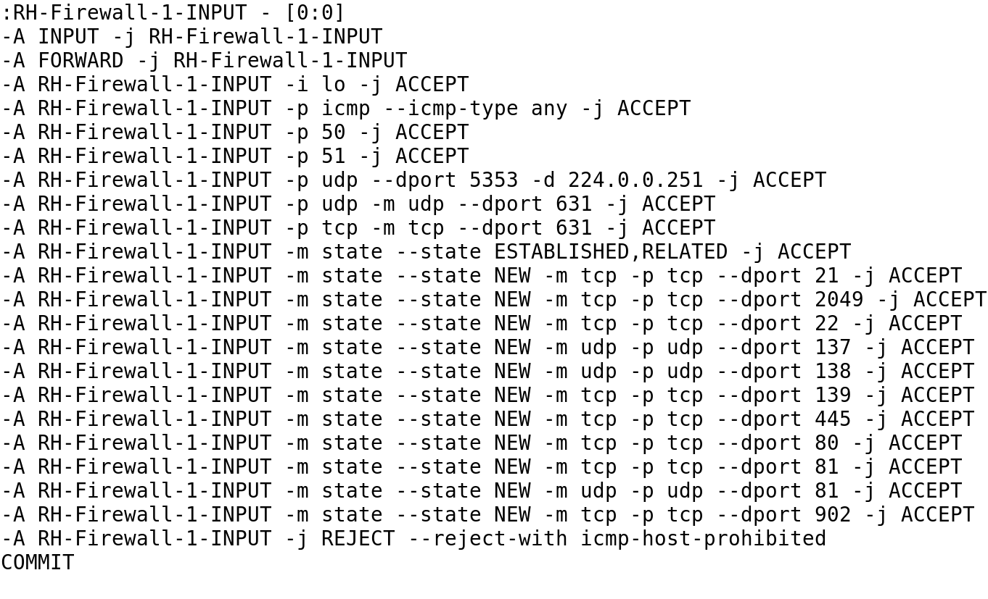
Firewall Rules from /etc/sysconfig/iptables

Slide 15
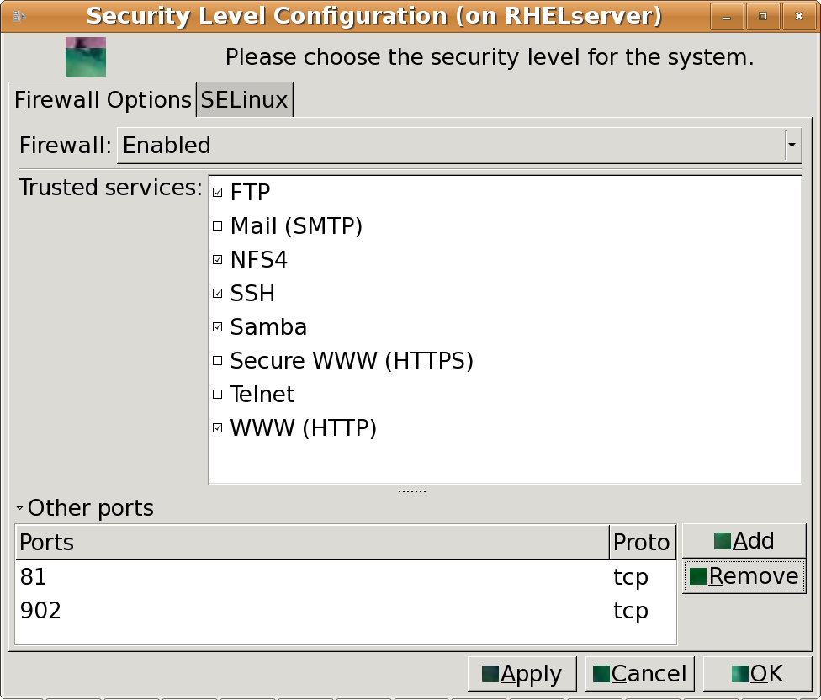
GUI Security Level Configuration Tool

Slide 16
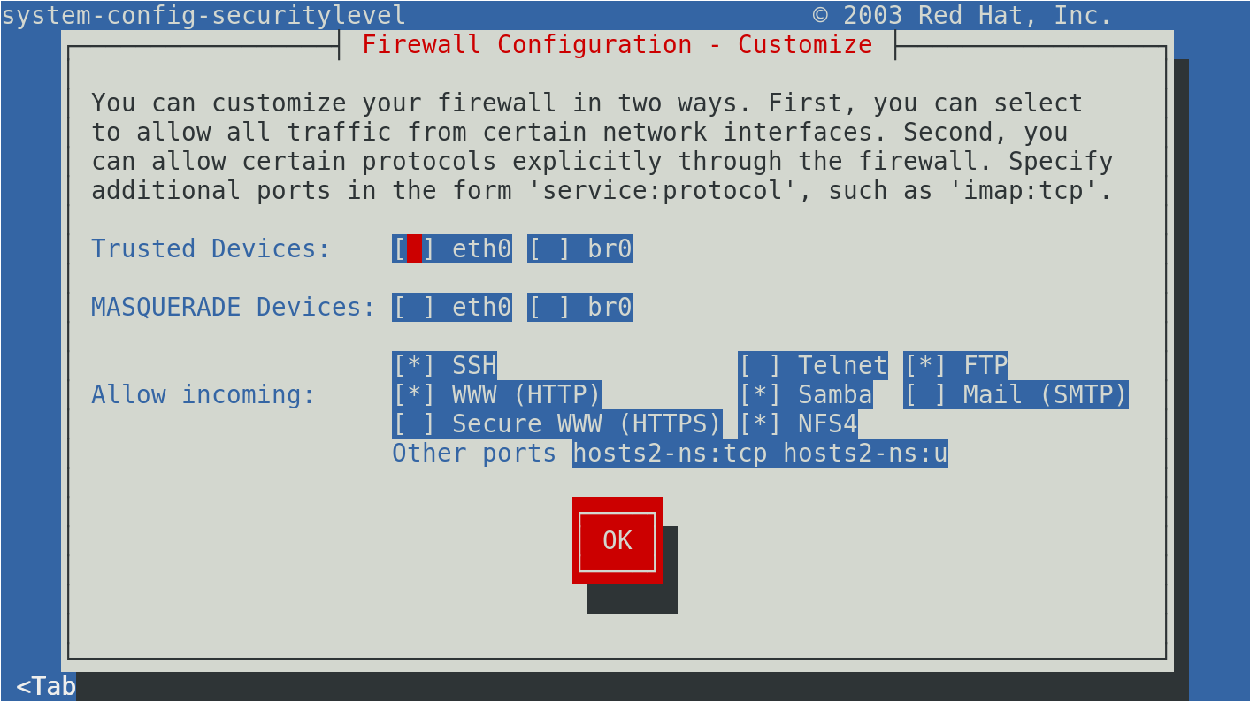
Console-based Security Level Configuration Tool

Slide 17
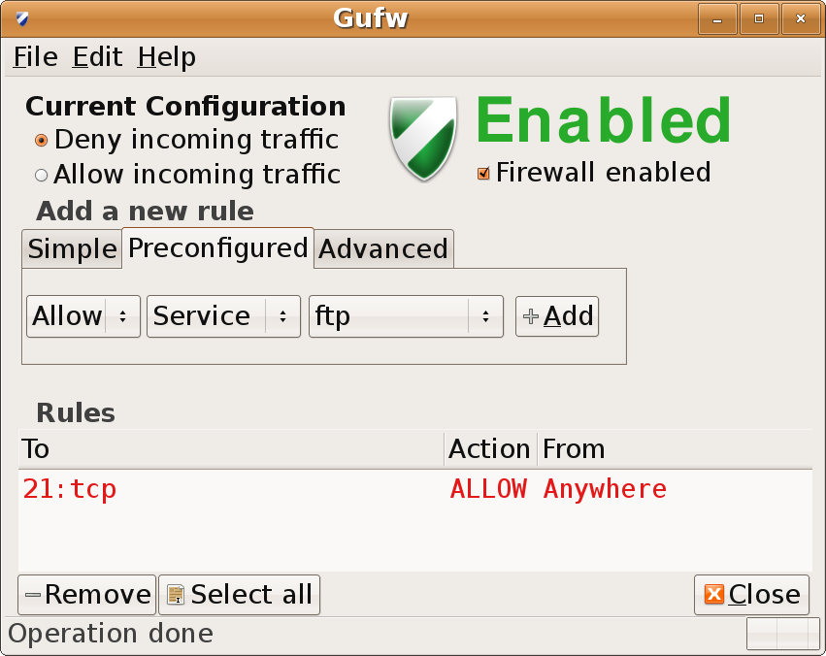
GNOME Uncomplicated Firewall (Gufw) Tool

Slide 18
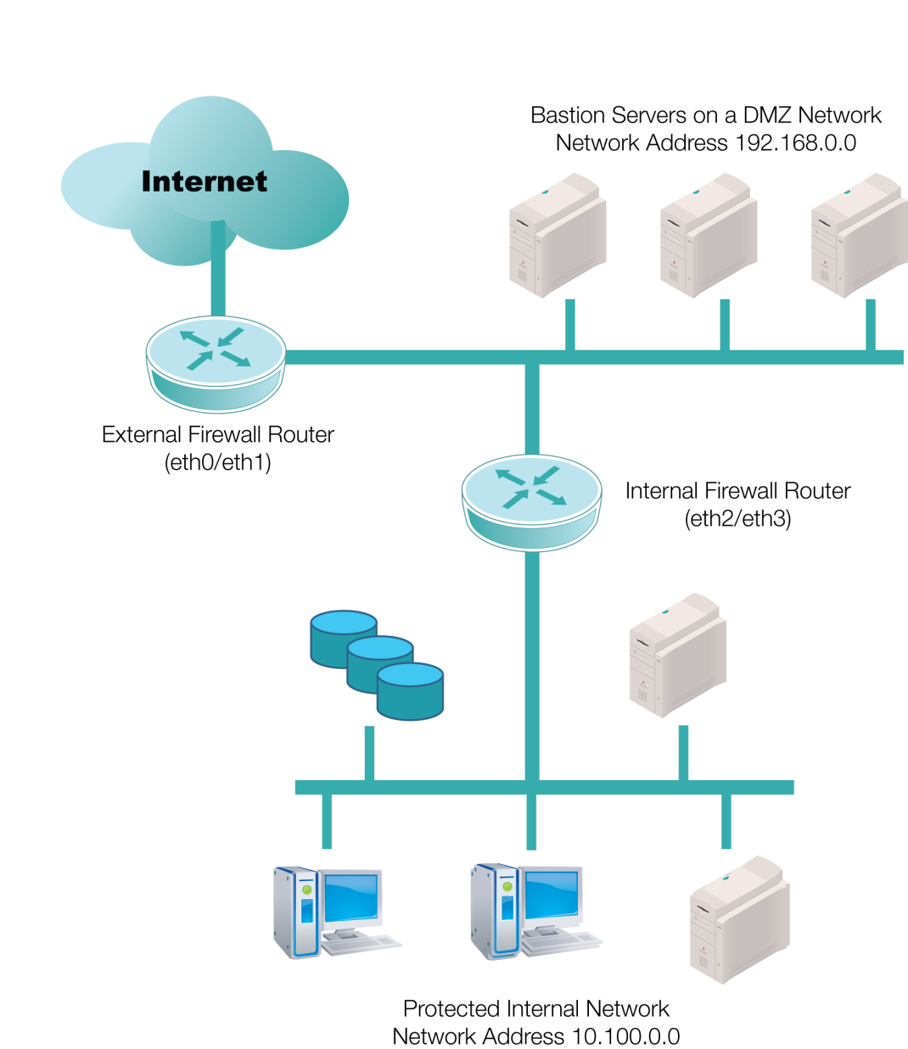
Bastion Servers in DMZ

Slide 19



Linux Firewall on a Bastion Host
Bastion host firewall allows
access only to Ports
80, 443, and 22
Port 80
Hypertext Transfer Protocol (HTTP)
Port 21
File Transfer Protocol (FTP)
Port 21
access is denied here
Perimeter firewall allows access
to Ports 80, 443, 22, and 21

